Slide 1
Employee Data Analysis using Excel
STUDENT NAME: SADHANA.N
REGISTER NO: 122204037
DEPARTMENT: B.COM CS
COLLEGE: Shri Krishnaswamy College for Women

Slide 2
PROJECT TITLE
Employee Performance Analysis using Excel

Slide 3


AGENDA
Project Overview
Problem Statement
End Users
Our Solution and Proposition
Dataset Description
Modelling Approach
Results and Discussion
Conclusion
3/21/2024 Annual Review

Slide 4

PROBLEM STATEMENT
Employee performance evaluation is a crucial aspect of any successful organization’s strategy. It’s not just a routine task or an HR formality; it’s a powerful tool that can shape the future of your company. In this blog, we delve deep into the reasons why employee performance evaluation should be a top priority for your business.
Today’s fiercely competitive business landscape presents greater challenges in the quest to attract and retain top talent than ever before. To stay ahead, businesses must continuously assess and enhance their workforce’s capabilities.
The primary purpose of performance evaluation is to provide feedback, evaluate accomplishments, identify areas for improvement, and make informed decisions regarding career development, compensation, promotions, and other HR-related matters.

Slide 5

PROJECT OVERVIEW
A performance evaluation is a snapshot of an employee's performance over a period of time. It’s a formal process that celebrates accomplishments, quantifies the value an employee brings to the company, creates a feedback loop for future improvement, and motivates employees to keep growing.
Evaluating and measuring employee performance makes sure your employees are efficiently performing and alerts you to those who aren’t working at the levels they should be.
Employee performance analytics is the act of analyzing HR data to measure how your employees are performing against KPIs. These KPIs are role-specific performance goals, metrics, or standards that are tied to your larger business goals.

Slide 6

WHO ARE THE END USERS?
Every performance evaluation should be directly tied with that employee’s job description. Determining who should evaluate the performance of the employee is the next decision. It could be their direct manager ( most common method ), subordinates, customers or clients, self, and/or peers.
This Photo by Unknown Author is licensed under CC BY-SA

Slide 7

OUR SOLUTION AND ITS VALUE PROPOSITION
Conditional Formatting – To Highlight the Missing Values
Filtering – To Remove the Missing Values
Formula – To Calculate the Employee performancelevel
Pivot – To Summarize
Graph – For data visualization
Pie Chart – For data visualization

Slide 8

Dataset Description
EMPLOYEE PERFORMANCE ANALYSIS DATA SET IS TAKEN FROM EDUNET
DESCRIPTION
TOTAL FEATURES – 26, FEATURES TAKEN FOR CONSIDERATION – 9
EMP ID – NUMBER
NAME – TEXT
EMPLOYEE TYPE
PERFORMANCE LEVEL
GENDER – MALE FEMALE
EMPLOYEE RATING – NUMBER
BUSINESS TYPE
FIRST NAME
LAST NAME
EXIT DATE (USING CONDITIONAL FORMATTING)

Slide 9

THE "WOW" IN OUR SOLUTION
Performance level formula: = IFS ( Z8>=5,”VERY HIGH”,Z8>=3,”MED”,”TRUE”,”LOW”)
3/21/2024 Annual Review
9

Slide 10
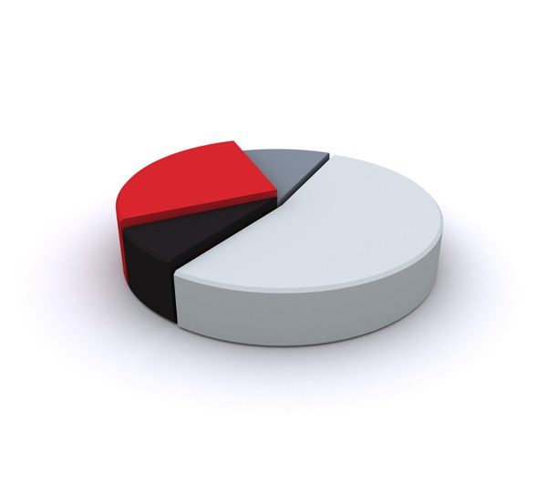
MODELLING
COLLECTION: Collected the data from EDUNET Data set which was mentioned in the class
FEATURE COLLECTION: Selected 9 specific features from the total of 26 features
DATA CLEANING: A) Identifying the missing values
B) Filtering the missing values
PERFORMANCE LEVEL: Applied the performance level formula
=IFS(Z8>=5,”VERY HIGH”,Z8>=3,”MED”,”TRUE”,”LOW”)
5. SUMMARY: A) Using the Pivot table classify the necessary fields
B) Highlight the necessary data
VISUALIZATION: A) Recommended graph
B) Pie Chart
10

Slide 11
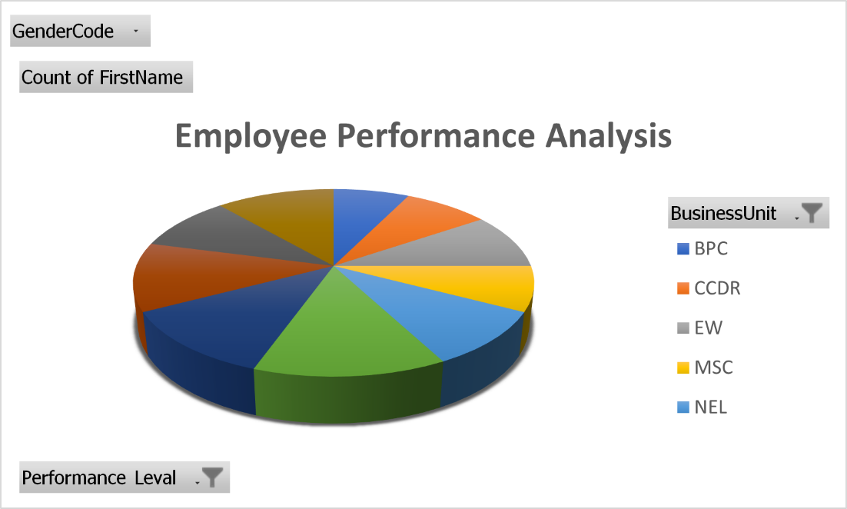
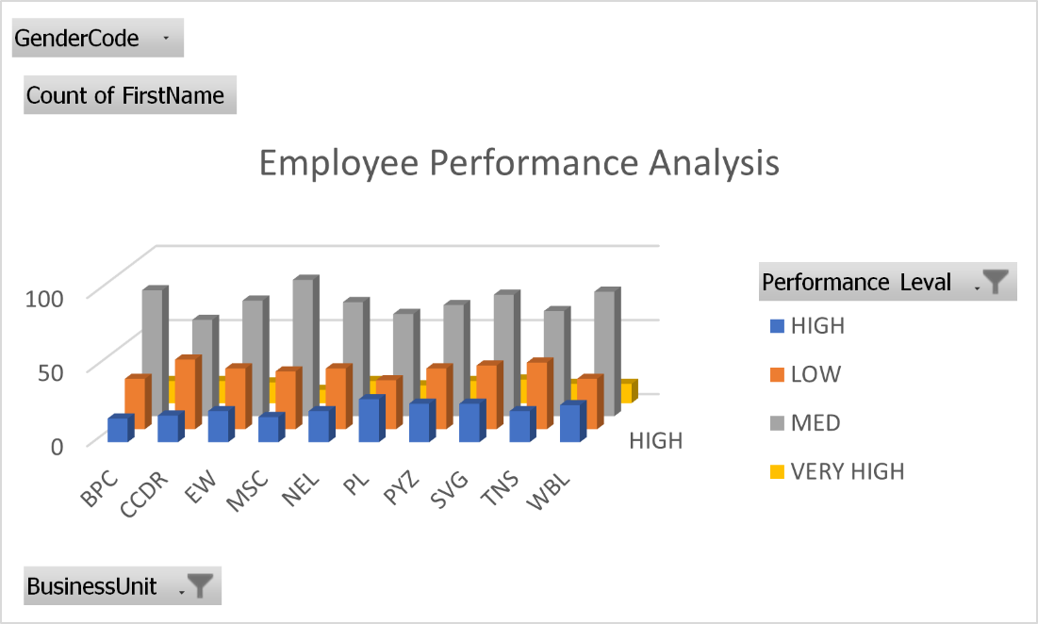
RESULTS
11

Slide 12

Conclusion
According to the graph, the performance of the employees are expo line low of 40 and there are classification of high, very high and medium.

